Slide 1
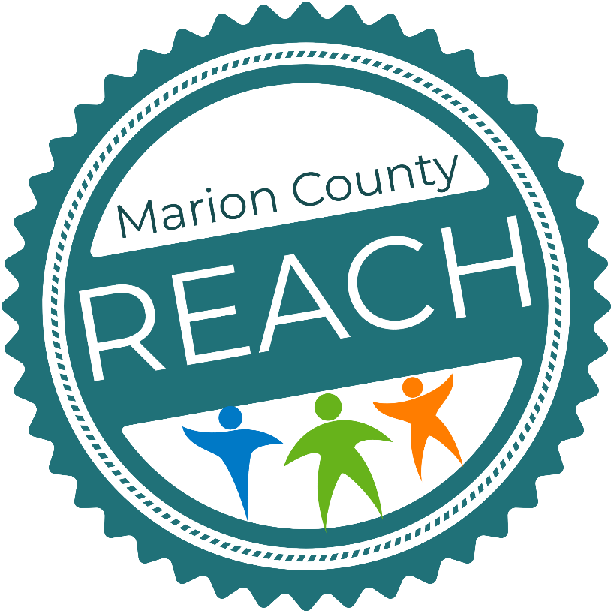
REACH
REACHing for a Healthier Marion County
Johnnie Washington, MSW, CCHW
Community Health Liaison
Minority Health Coalition of Marion County

Slide 2
Creating Better Health for ALL
About Us:
Minority Health Coalition of Marion County (MHCMC) is a non-profit organization of concerned citizens, health professionals and advocates determined to impact the health status of at-risk minorities in Marion County.
MHCMC strives to empower citizens to take a proactive approach to improve their quality of life and reduce existing health disparities and deficiencies.
MHCMC addresses the health needs of the community in relation to the ten leading causes of death for minorities in Marion County (Heart Disease, Cancer, Stroke, Diabetes, Homicide, Accidents, COPD, Kidney Disease, Infant Mortality and Suicide. Some of the other principal conditions affecting minorities include HIV).
Source: Community View Collaboration. Saskatoon Health Region. Public Health Observatory: Population and Public Health.
2014 June. Advancing Health Equity in Health Care:
What is Health Equity? A Primer for the Health Care System. http://www.communitvview.ca/pdfs/2014_shr_phase3_whatishealthequity.pdf

Slide 3
Creating Better Health for ALL
About Us:
MHCMC Programs:
Minority Health Initiative
Indianapolis Healthy Start Initiative
Substance Use Outreach Services
Minority Tobacco Cessation & Prevention
End the HIV Epidemic Survey for Faith Leaders
REACH (Racial Ethnic Approaches to Community Health)
MHCMC continues to work closely with the Marion County Public Health Department on dispelling health disparities in the minority communities and REACHing for a Healthier Marion County.
Source: Community View Collaboration. Saskatoon Health Region. Public Health Observatory: Population and Public Health.
2014 June. Advancing Health Equity in Health Care:
What is Health Equity? A Primer for the Health Care System. http://www.communitvview.ca/pdfs/2014_shr_phase3_whatishealthequity.pdf

Slide 4
What is REACH?
Racial and
Ethnic
Approaches to Community
Health
Only CDC program focused on racial inequities in chronic disease
Emphasizes PSE changes
Policy
Systems
Environment
Uses community-based approach

Slide 5
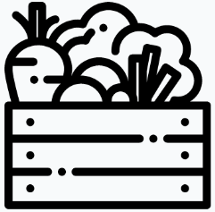
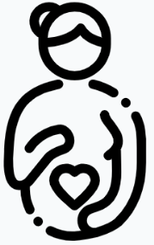
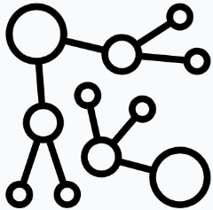
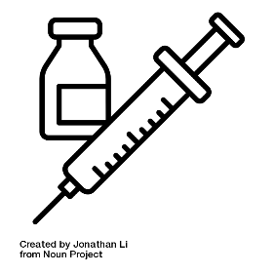
Marion County REACH Focus PSE Changes in 6 Areas:
What is REACH?
Food Systems
Breastfeeding
Physical Activity
Food Service Guidelines
Community Clinical Linkages
COVID-19 Vaccination Outreach

Slide 6
What We’re Doing
What is REACH?
The Reach Team consist of the MCPHD Chronic Disease, Community Hospital Network, Health By Design and the Minority Health Coalition of Marion County (MHCMC)
Food Systems
Breastfeeding
Physical Activity
Helping neighborhoods identify key projects to make spaces more walkable
Training neighbors to advocate for things that make it safer and easier to walk and wheel to everyday places
Fresh Bucks Program
Produce Rx program
Helping local food retailers offer healthier options
Food Service Guidelines
Community Clinical Linkages
COVID-19 Vaccination Outreach
Offering healthier food items at Community Hospital East
Helping local pantries offer and encourage healthier foods
Connecting people to information and resources about COVID-19 Vaccines

Slide 7
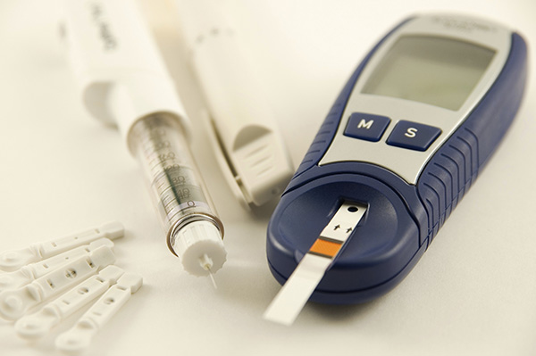
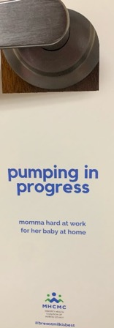
REACHing for a Healthier Marion County
MHCMC Community
Health Liaison Role
(under the REACH
Program)
Community Clinical Linkages (CCL):
Promote participation in and create linkages between small worksites, community-based organizations, faith-based groups and provide resources to individuals that live in food dessert areas.
Build clinical community linkages to ensure higher participation in community-based diabetes prevention, self management education and support.
Helping community-based health programs and clinics connect to each other and share referrals and information
Breastfeeding
Breastfeeding support services/Awareness:
Indiana Black Breastfeeding Coalition to increase their capacity
Assess churches and businesses to assist growing their breastfeeding support
Raise awareness of and normalize breastfeeding in the community
Community Clinical Linkages

Slide 8
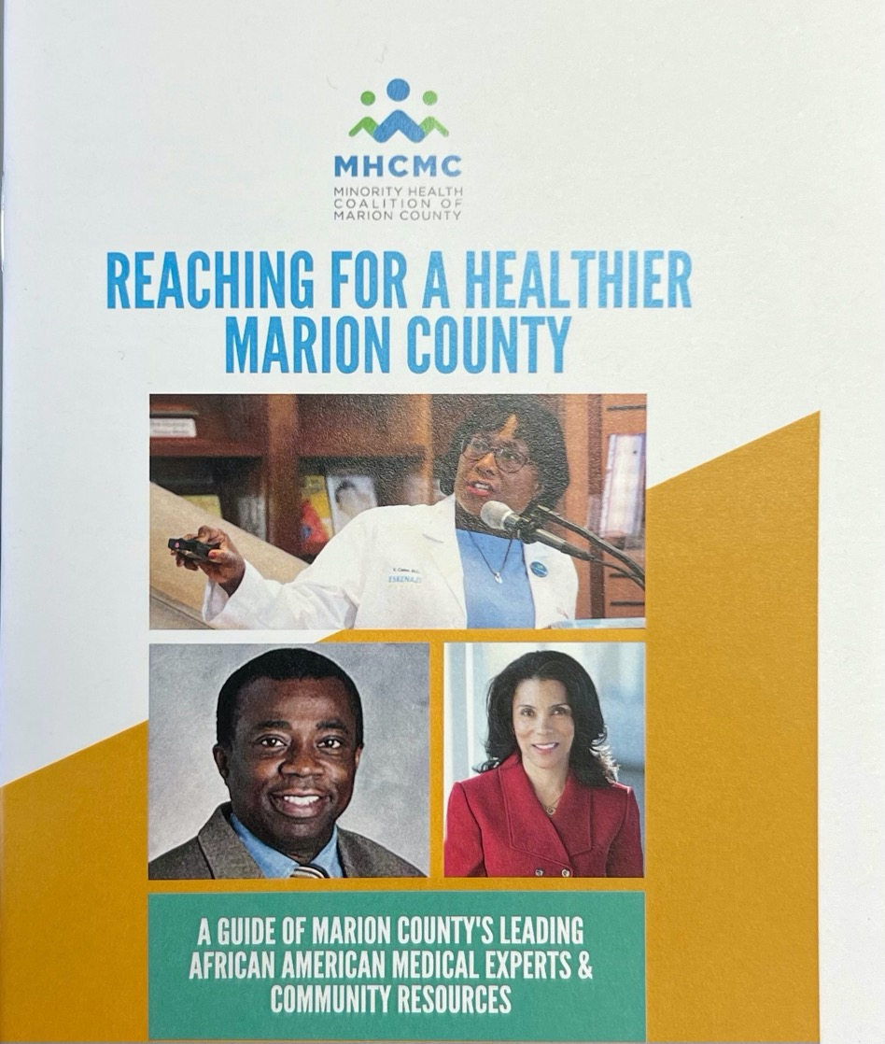
REACHing for a Healthier Marion County
Advocating and Encouraging the use of Health Education & Community Resources
Too Sweet For Your Own Good:
Managing Diabetes Virtual Conference
ABC’S of Diabetes
African American Medical Experts & Community Resources Directory
FREE
Four-part series including instruction on medications, nutrition, exercise, monitoring, complications and available community resources.
Open to anyone with diabetes,
pre-diabetes, family members
and friends.
All classes are offered virtually

Slide 9
Strategies Working Towards Equity
Equality Does Not Necessarily Mean Equity!
However, each strategy working together is another “box” towards achieving equity.
Breastfeed
Food Service
Guidelines
Food System
CCL
Covid 19
Vaccine
Phys. Act
Source: Community View Collaboration. Saskatoon Health Region. Public Health Observatory: Population and Public Health.
2014 June. Advancing Health Equity in Health Care: What is Health Equity? A Primer for the Health Care System. http://www.communitvview.ca/pdfs/2014_shr_phase3_whatishealthequity.pdf

Slide 10
QUESTIONS ?
Johnnie Washington, MSW, CCHW
Community Health Liaison
Minority Health Coalition of Marion County
317-926-1170
jwashington@myhealthmc.com
THANK YOU

